Slide 1
Scripting Basics

Slide 2
Scripting
OpenDSS is a scriptable solution engine
Scripts
Series of commands
From text files
From edit forms in OpenDSS.EXE
From another program through COM interface
e. g., This is how you would do looping
Scripts define circuits
Scripts control solution of circuits
Scripts specify output, etc.

Slide 3
Command Syntax
Command parm1, parm2 parm3 parm 4 ….
Parameters may be positional or named (tagged).
If named, an "=" sign is expected.
Name=value (this is the named form)
Value (value alone in positional form)
For example, the following two commands are equivalent:
New Object="Line.First Line" Bus1=b1240 Bus2=32 LineCode=336ACSR, …
New “Line.First Line”, b1240 32 336ACSR, …
Comma or white space

Slide 4
Delimiters
Array or string delimiter pairs: [ ] , { },( ),“ “,‘ ‘
Matrix row delimiter: |
Value delimiters: , (comma) any white space (tab or space)
Class, Object, Bus, or Node delimiter: . (period)
Keyword / value separator: =
Continuation of previous line: ~ (More)
Comment line: //
In-line comment: !
Query a property: ?

Slide 5
Array and Matrix Parameters
Array
kvs = [115, 6.6, 22]
kvas=[20000 16000 16000]
Matrix
(3x3 matrix)
Xmatrix=[1.2 .3 .3 | .3 1.2 3 | .3 .3 1.2]
(3x3 matrix – lower triangle)
Xmatrix=[ 1.2 | .3 1.2 | .3 .3 1.2 ]

Slide 6
A Basic Script
Clear
New Circuit.Simple ! Creates voltage source (Vsource.Source)
Edit Vsource.Source BasekV=115 pu=1.05 ISC3=3000 ISC1=2500 !Define source V and Z
New Transformer.TR1 Buses=[SourceBus, Sub_Bus] Conns=[Delta Wye] kVs= [115 12.47]
~ kVAs=[20000 20000] XHL=10
New Linecode.336ACSR R1=0.058 X1=.1206 R0=.1784 X0=.4047 C1=3.4 C0=1.6 Units=kft
New Line.LINE1 Bus1=Sub_Bus Bus2=LoadBus Linecode=336ACSR Length=1 Units=Mi
New Load.LOAD1 Bus1=LoadBus kV=12.47 kW=1000 PF=.95
Solve
Show Voltages LN Nodes
Show Currents Element
Show Powers kVA Elements
(You can Copy and Paste this into OpenDSS.EXE

Slide 7
Example: IEEE 8500-Node Test Feeder
– an example of a large circuit

Slide 8
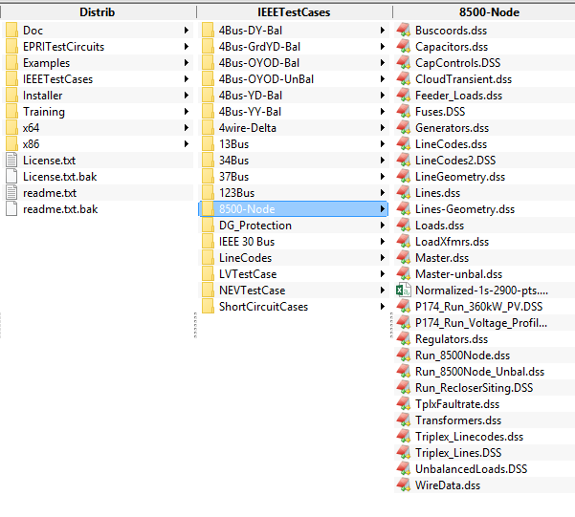
Location of the IEEE 8500-Node Test Feeder Files

Slide 9
Scripting Large Circuits
For small circuits, it is often sufficient to put all the scripts in a single file
Many of the IEEE test feeder examples are mostly in a single file
When you have large amounts of data, a more disciplined approach is recommended
Redirect Command
Redirects the input to another file
Returns to home directory
Compile Command
Same as Redirect except repositions home directory

Slide 10
A Common Sense Structuring of Script Files
Run_The_Master.DSS
“Compile” the Master file from here
Master.DSS
LineCodes.DSS
WireData.DSS
LineGeometry.DSS
Libraries
Put a “Clear” in here
(Clearall for parallel processing)
Spectrum.DSS
LoadShape.DSS
Transformers.DSS
Lines.DSS
Circuit Definition
Make a separate folder for each circuit
Loads.DSS
Etc.

